Slide 1
Arduino-controlled beer fermenter thermostat and heater Jonathon Bisiach

Slide 2
Homebrew basics
Typical ingredients:
grain (typically malted barley)
sugar
hops
water
yeast
Volume typically 19 - 23L
Ferments for 7 to 9 days before bottling

Slide 3
Temperature is critical
Too cold and yeast remains dormant – no fermentation
Too warm and yeast becomes over-active – brew develops undesirable ‘green apple tang’

Slide 4
Not all beers are created equal
English ale yeast – 15-35C
American ale yeast – 18-28C
Lager yeast – 12-15C
Weiss yeast – 18-24C
Belgian trappist yeast – 15-20C

Slide 5
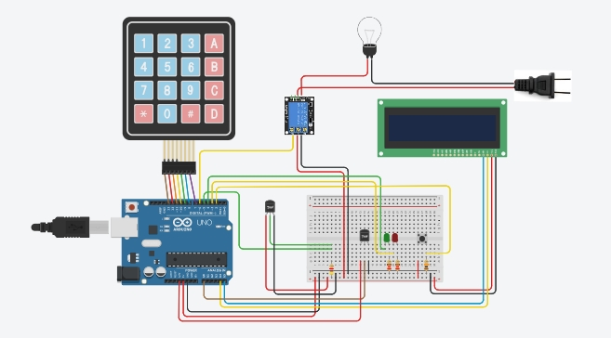
An elegant solution

Slide 6
Features
Thermostatically-controlled heater
LCD interface
User able to input temperature range using numeric keypad
LED signals when heater is active
Button-push interrupt displays current temperatures and selected temperature range

Slide 7
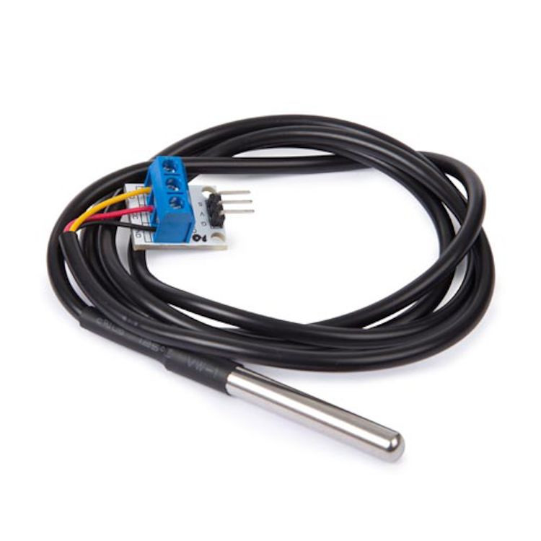
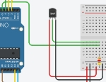
The thermostat

Slide 8
The thermostat
The DS18B20 communicates over a one-wire bus that requires only one data line (and ground) for communication with a central microprocessor.
Operating temperature range of -55°C to +125°C and is accurate to ±0.5°C over the range of -10°C to +85°C

Slide 9



The thermostat
Libraries:
Setup:
Execution:

Slide 10
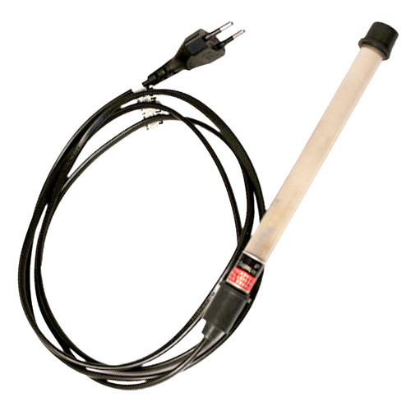
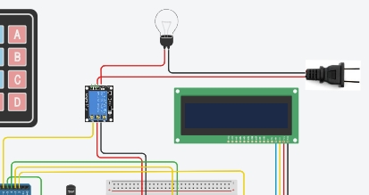
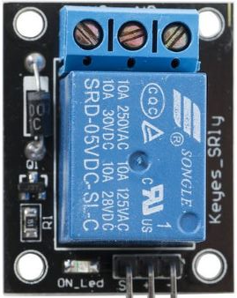
5V relay and heater

Slide 11
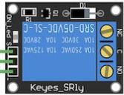
5V relay and heater
SRD-05VDC-SL-C relay acts like a latch that controls current to a high-voltage device
The relay can be initially set to be either open (NO) or normally closed (NC) depending on whether the 5V signal turns the latch on or off

Slide 12

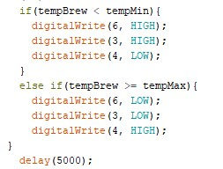
5V relay and heater
Setup:
Execution:

Slide 13
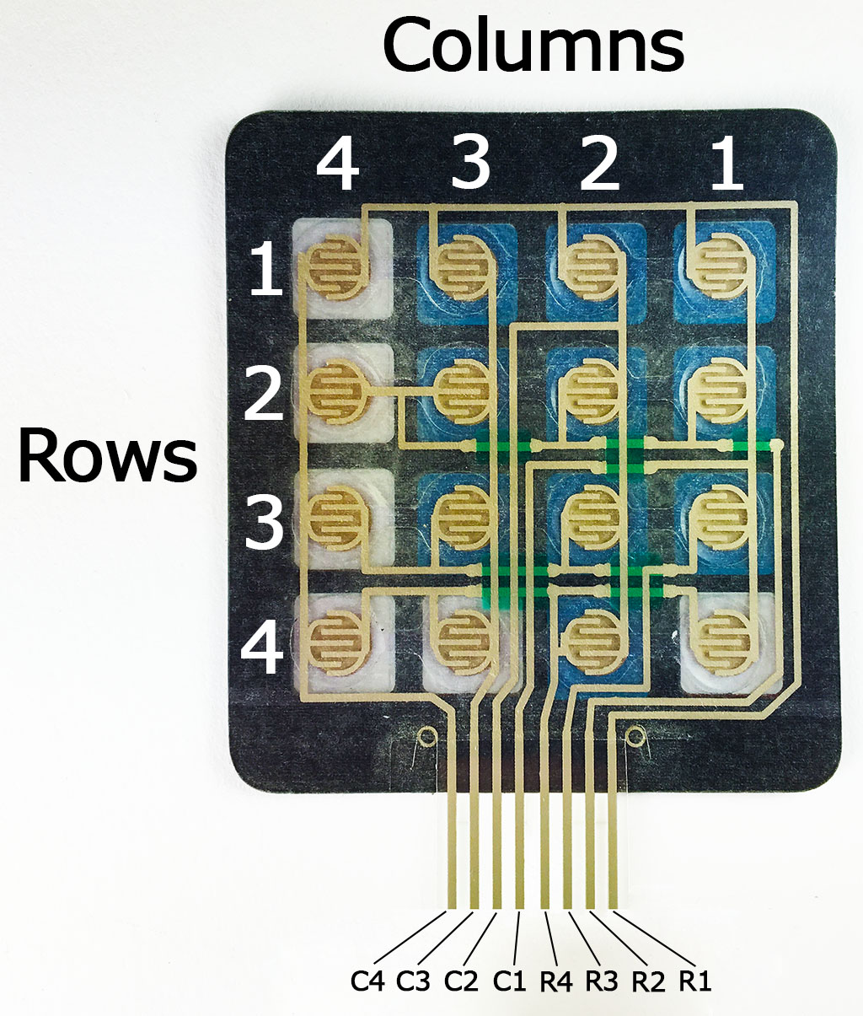
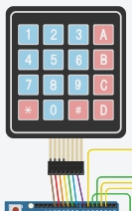
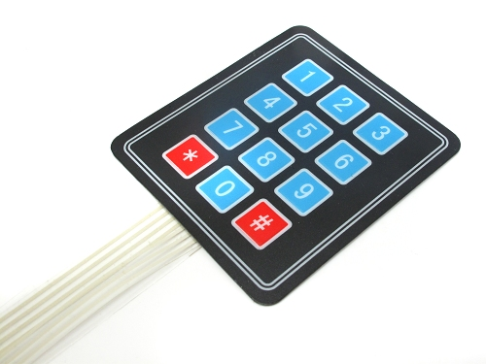
The keypad

Slide 14
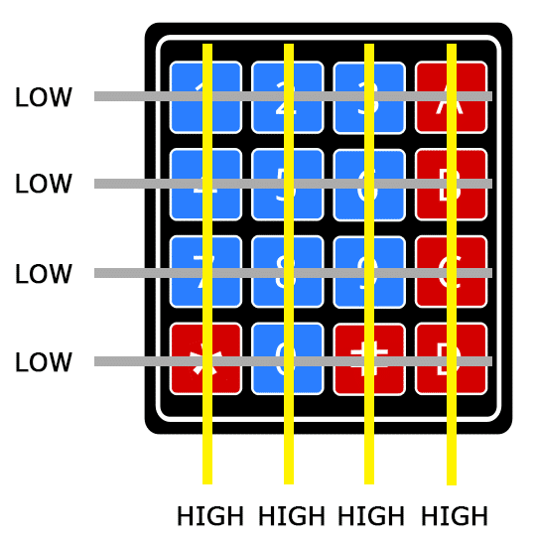
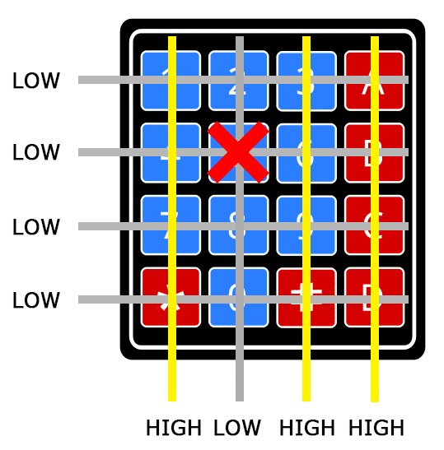
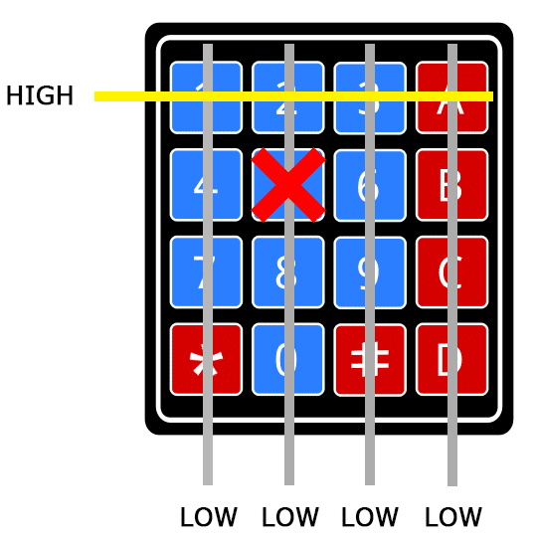
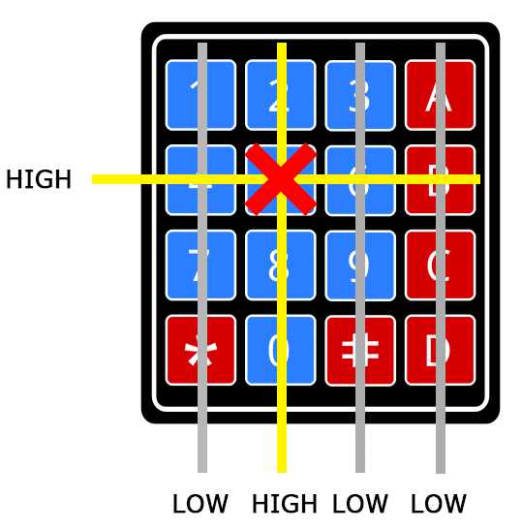
The keypad

Slide 15
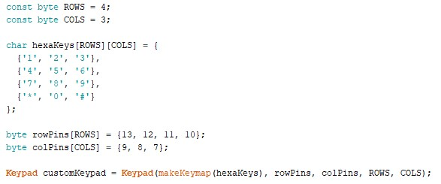
The keypad
Libraries:
Setup:

Slide 16
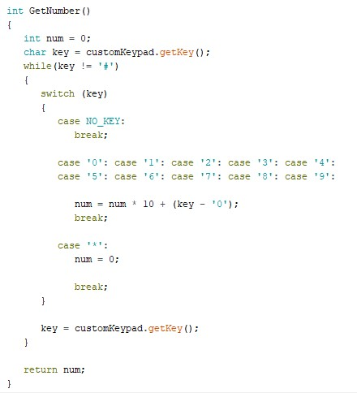
The keypad
Execution:

Slide 17
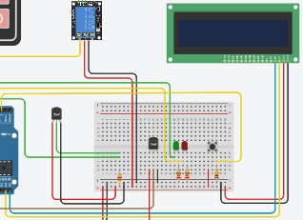
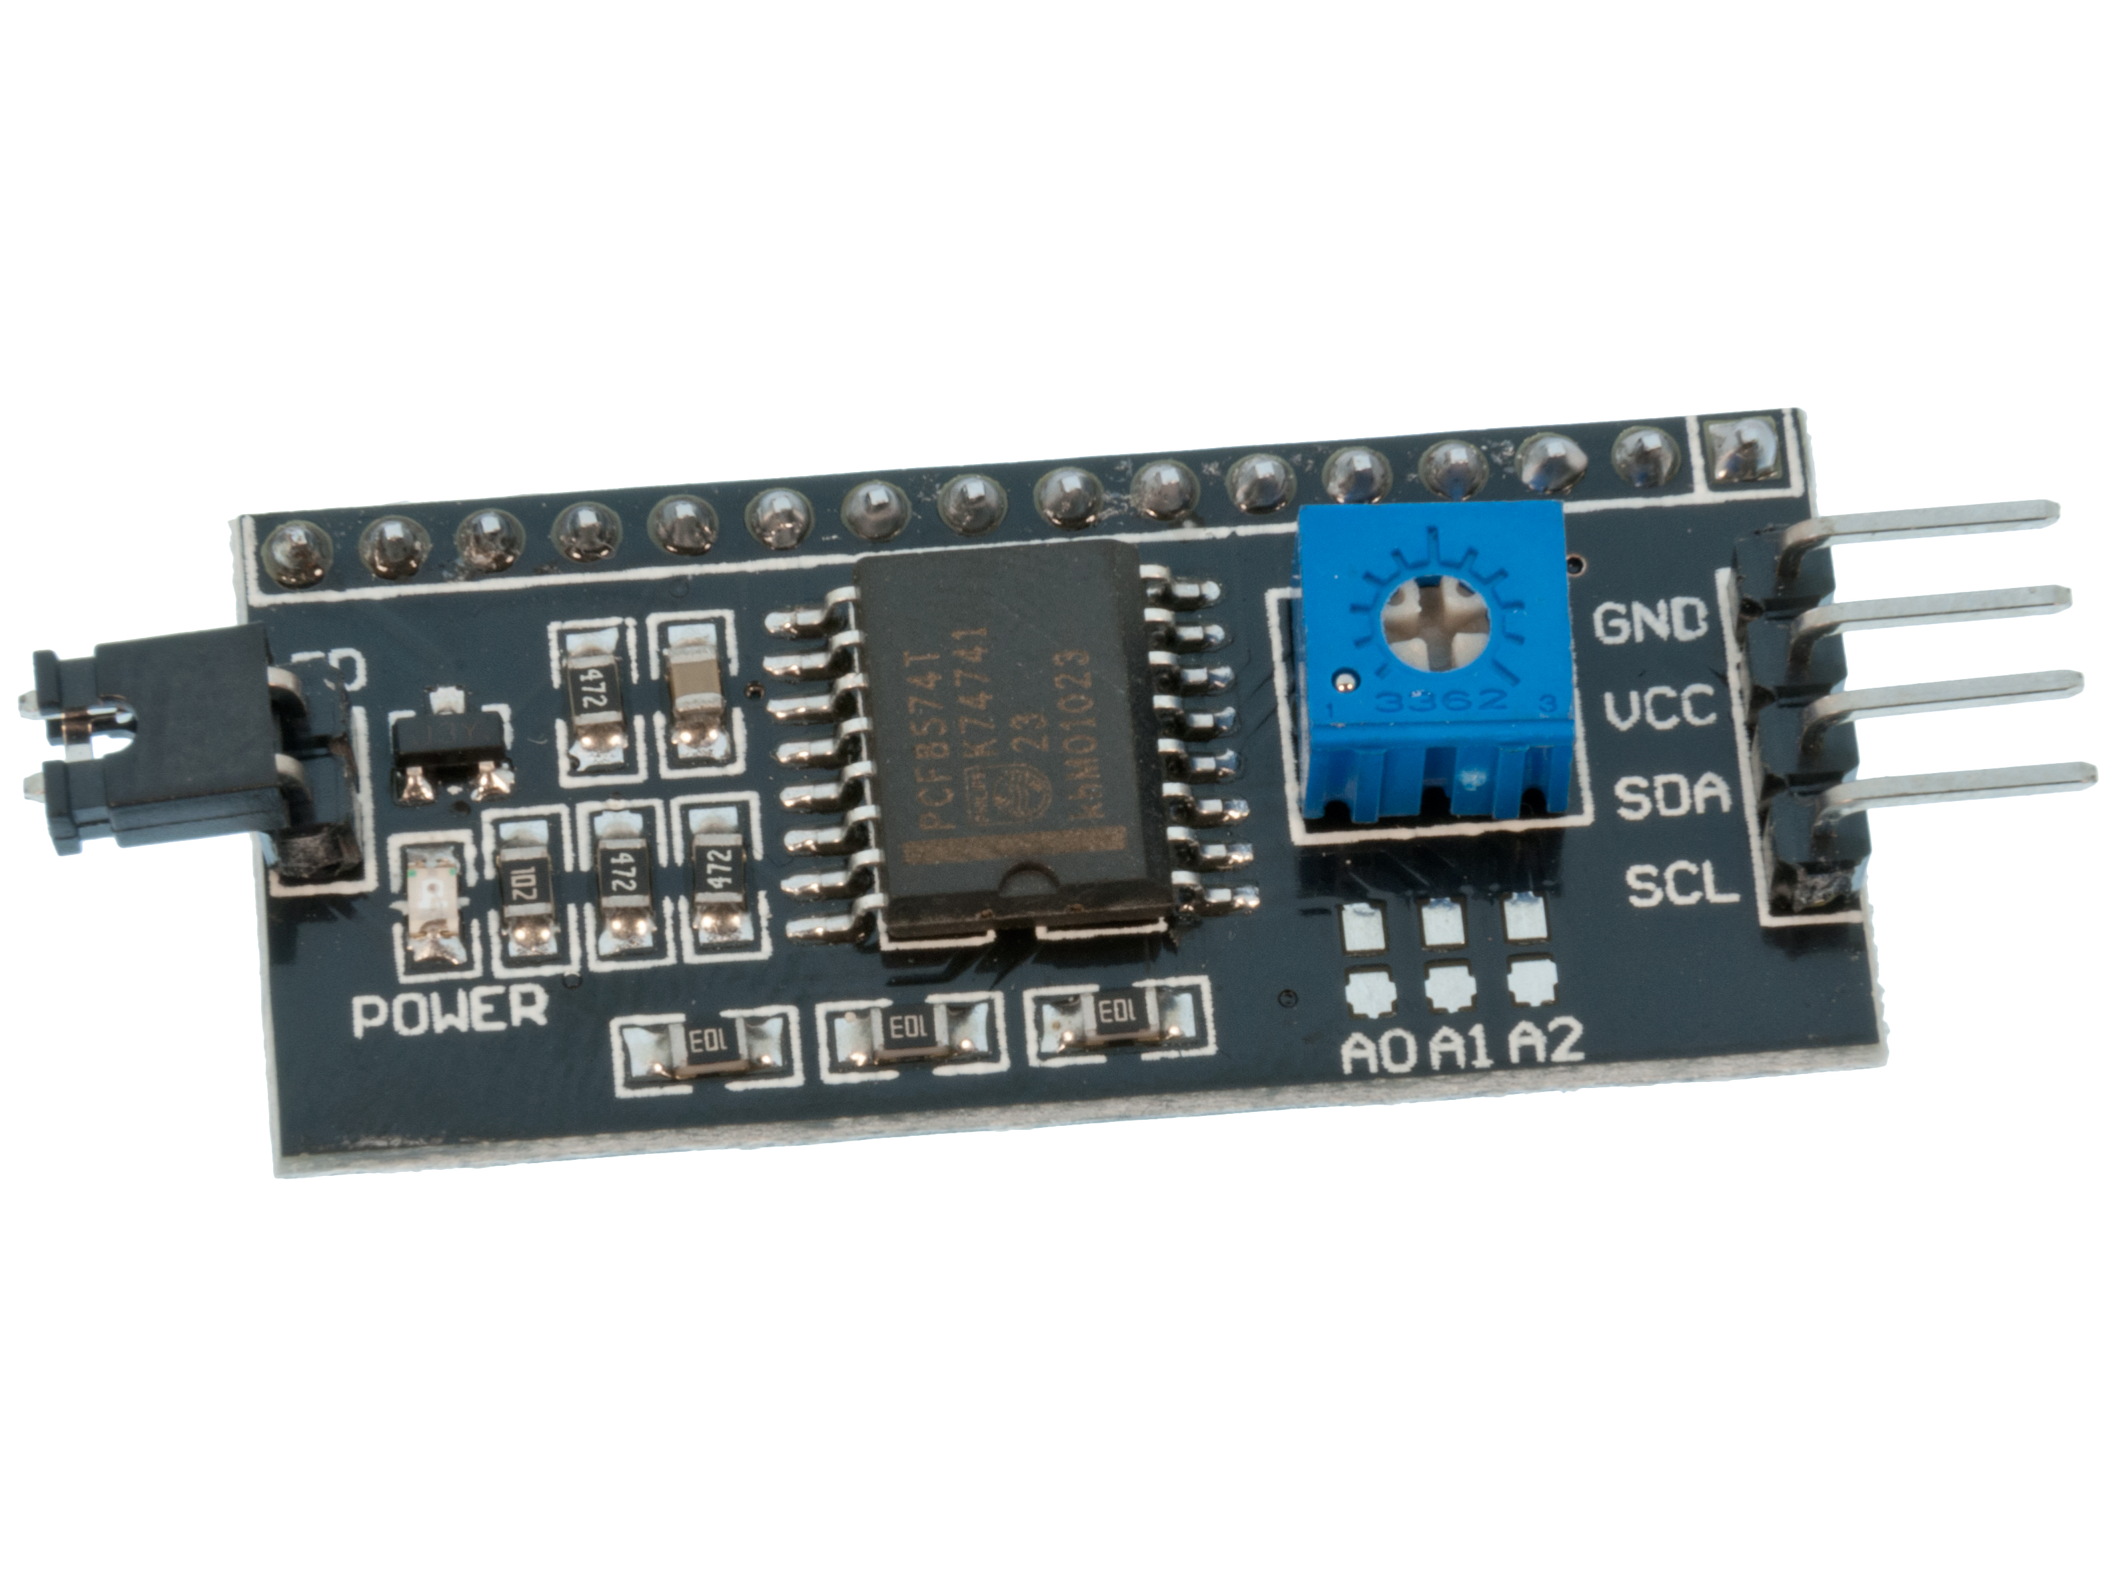
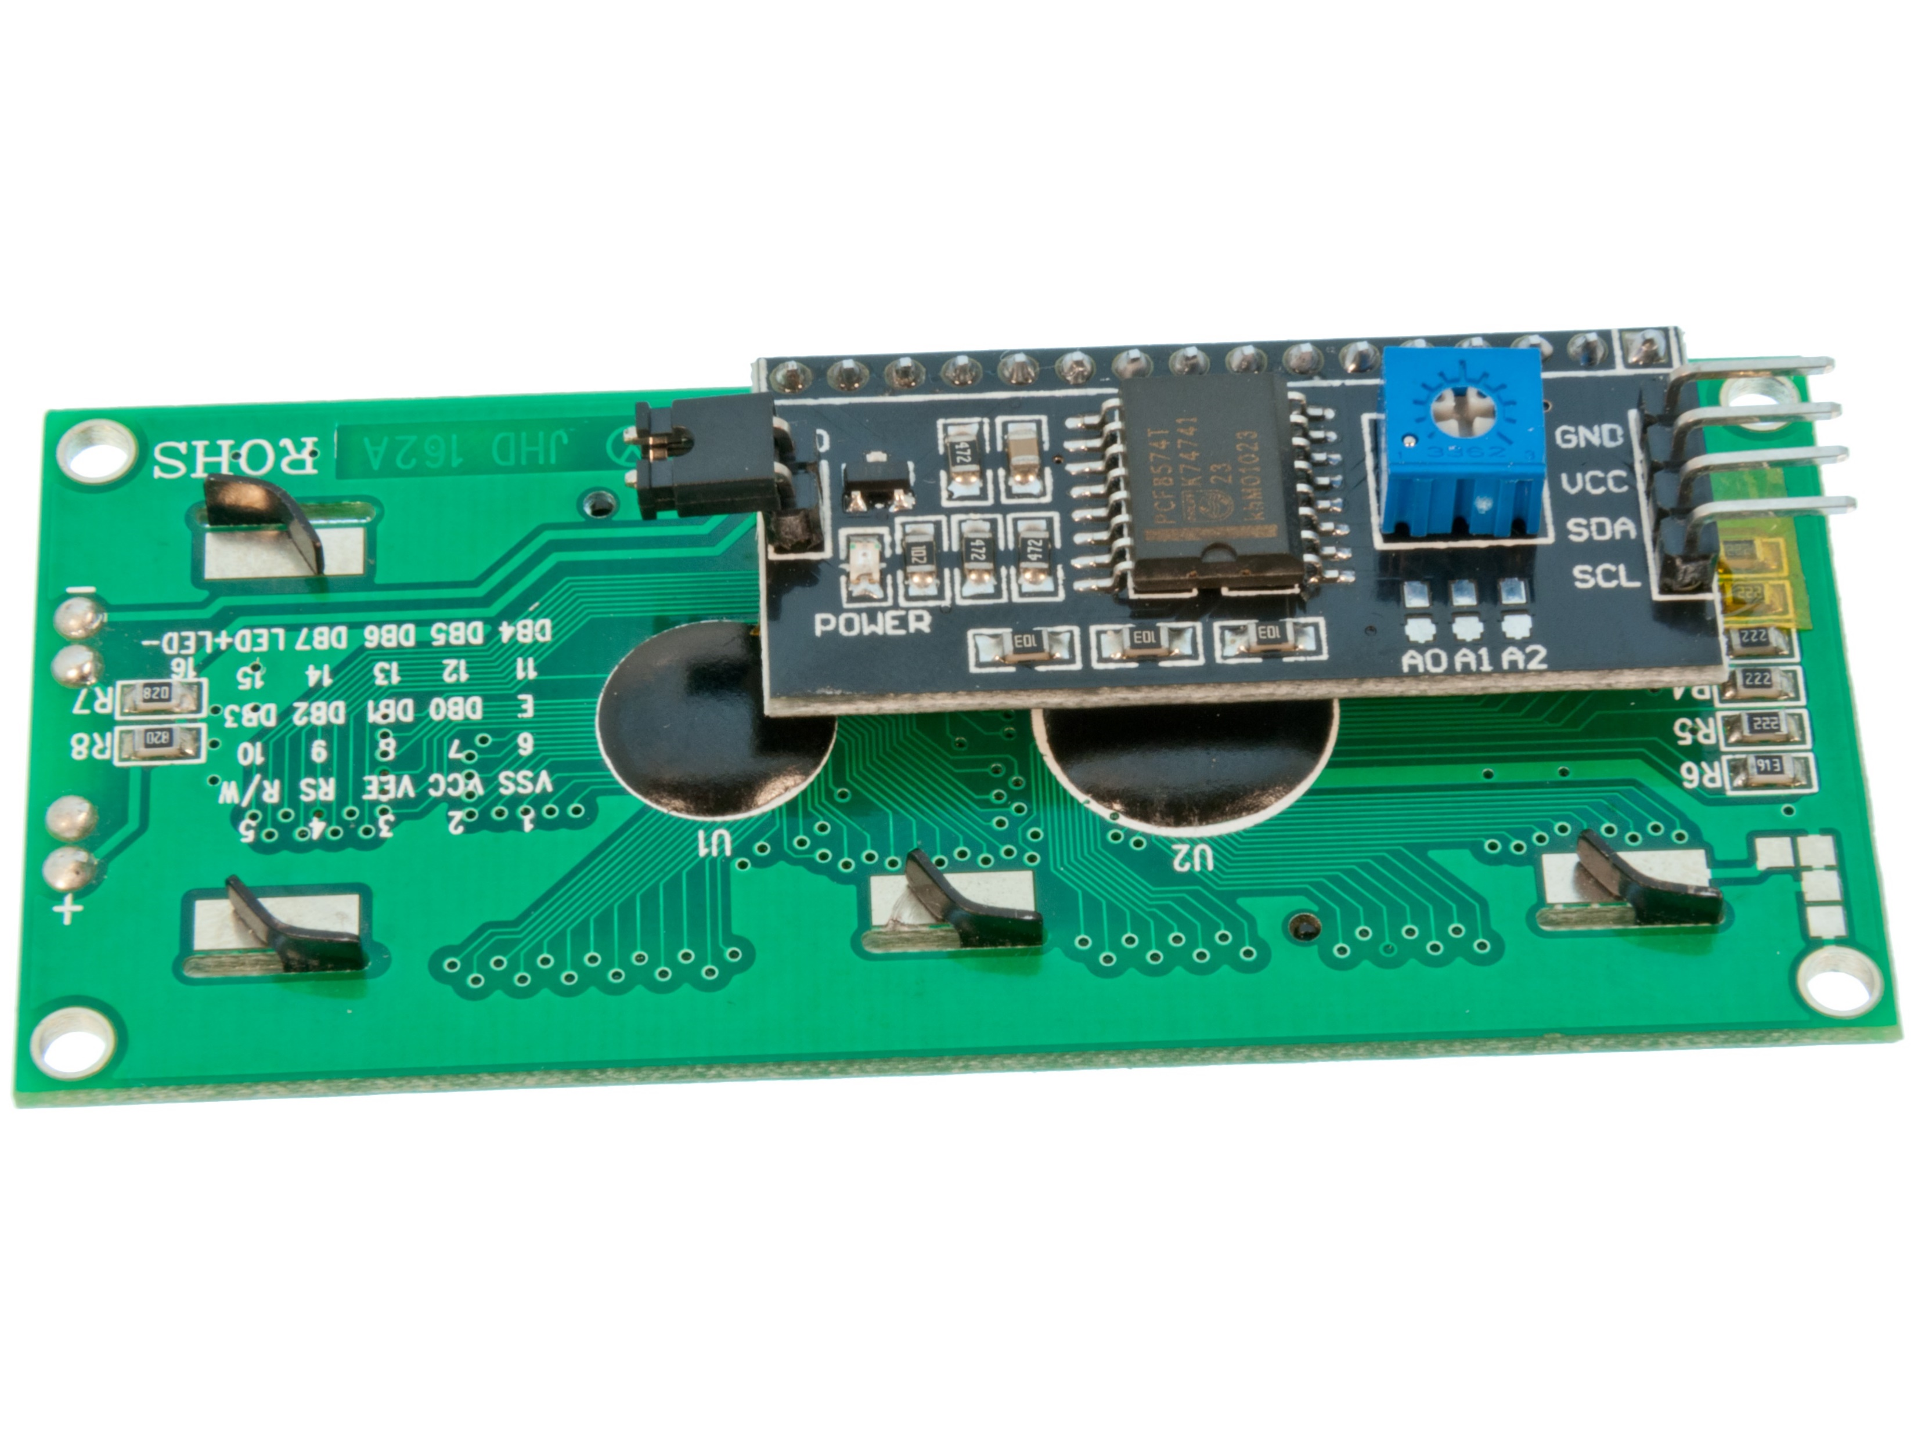
The LCD

Slide 18
I2C
I2C (I-square-C) means inter-integrated communication protocol; usually used to communicate between one master and multiple slaves
Can be reduce the number of connections – reduces the number of connections using the LCD from 12 to 4
Also known as ‘2-line protocol’
Each I2C bus consists of two signals: SCL and SDA
SCL is the clock signal; SDA is the data signal

Slide 19

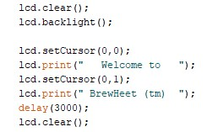
The LCD
Libraries:
Setup:
Execution:

Slide 20
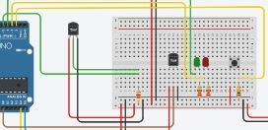
The board

Slide 21
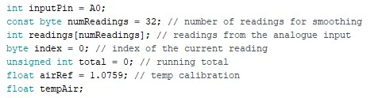
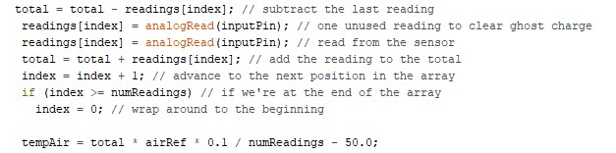
Air temperature (TMP36) thermometer
Setup:
Execution:

Slide 22
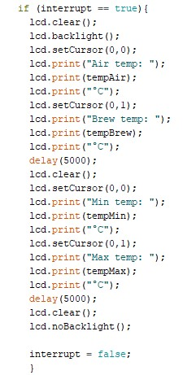

Switch-triggered interrupt
Setup: Execution:

Slide 24
References
How to set up a 5V relay on the Arduino
How to set up a keypad on an Arduino
How to Connect I2C LCD to Arduino Uno
DS18B20 (digital temperature sensor) and Arduino
Getting more precision out of TMP36 temperature sensor on Arduino Uno

